Slide 1
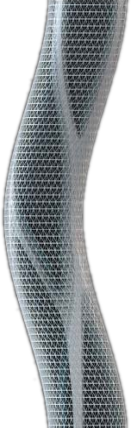

Quality Attributes for Domain Testing
Snejina Lazarova
Dimo Mitev
Senior QA Engineer, Team Lead
Senior QA Engineer, Team Lead
CRMTeam
SystemIntegrationTeam
Telerik QA Academy

Slide 2

Table of Contents
Testing of Software Characteristics
Quality Attributes for Domain Testing
Functional Accuracy
Functional Suitability
Functional Interoperability
Accessibility
Usability
Notes:
Book: Advanced Software Testing - Vol. 1 - Guide to the ISTQB Advanced Certification as an Advanced Test Analyst [2008]
ISTQB - Advanced Level Syllabus 2007 - section 5. Testing of Software Characteristics
Book: Software Testing, Ron Patton [2005] - Chapter 11. Usability Testing
Google ☺

Slide 3
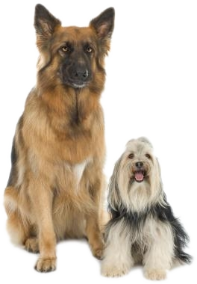
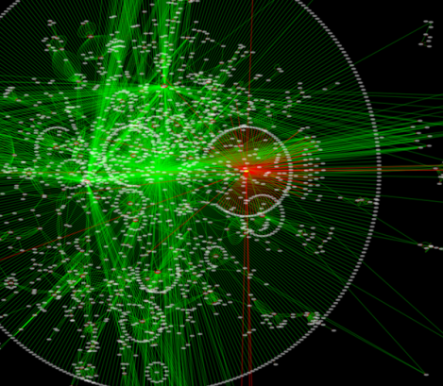
Testing of Software Characteristics

Slide 4

Why Bother With Quality Characteristics?
We need to understand the main quality characteristics in order to:
Recognize typical risks
Develop appropriate testing strategies
Specify effective tests

Slide 5

Functional vs. Non Functional Testing
Remember the difference between functional and non functional testing?
Functional testing
Focuses on what the system does
Non functional testing
Focused on how the system does what it does
Notes:
The functional requirements specify what the product must do. They relate to the actions that the product must carry out in order to satisfy the fundamental reasons for its existence.
Nonfunctional requirements are the properties that your product must have. Think of these properties as the characteristics or qualities that make the product attractive, or usable, or fast, or reliable.
Typical functional requirements are:
Business Rules
Transaction corrections, adjustments, cancellations
Administrative functions
Authentication
Authorization –functions user is delegated to perform
Audit Tracking
External Interfaces
Certification Requirements
Reporting Requirements
Historical Data
Legal or Regulatory Requirements
Typical non-functional requirements are:
Performance - Response Time, Throughput, Utilization, Static Volumetric
Scalability
Capacity
Availability
Reliability
Recoverability
Maintainability
Serviceability
Security
Regulatory
Manageability
Environmental
Data Integrity
Usability
Interoperability
http://searchsoftwarequality.techtarget.com/answer/Differentiating-between-Functional-and-Nonfunctional-Requirements
http://searchsoftwarequality.techtarget.com/answer/Functional-and-nonfunctional-requirements
http://searchsoftwarequality.techtarget.com/tip/The-Pareto-principle-for-well-defined-functional-software-requirements
http://www.lessons-from-history.com/node/83
Basically, functional requirements directly support the user requirements by describing the "processing" of the information or materials as inputs or outputs.
Nonfunctional requirements generally support all users in that they describe the business standards and the business environment, as well as the overall user's experience (user attributes).
Functional
Product features
Describe the work that is done
Describe the actions with which the work is concerned
Characterized by verbs
Nonfunctional
Product properties
Describe the character of the work
Describe the experience of the user while doing the work
Characterized by adjectives

Slide 6

Quality Attributes for Domain Testing

Slide 7

Basis for Functional Testing
Functional tests are based on functional requirements:
Written down requirements
Implicit requirements
Domain expertise of the tester

Slide 8
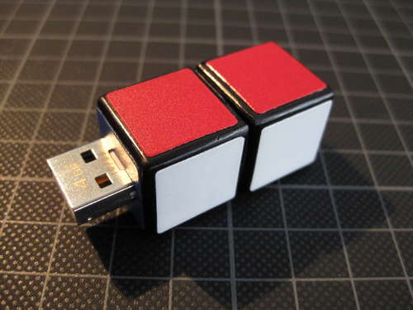
Quality Attributes
Functional testing is concerned with the following quality attributes:
Accuracy
Suitability
Interoperability
Accessibility
Usability

Slide 9

Functional Accuracy
Does the System Give the Right Answers

Slide 10

Functional Accuracy Testing
Functional accuracy testing
Concerned with adherence to specified or implied functional requirements
Does the system give the right answer?
Does the system produce the right effects?
Also refers to the right degree of precision in the results

Slide 11


Accuracy vs. Precision
High accuracy, low precision
High precision, low accuracy
Notes:
http://en.wikipedia.org/wiki/Accuracy_and_precision

Slide 12
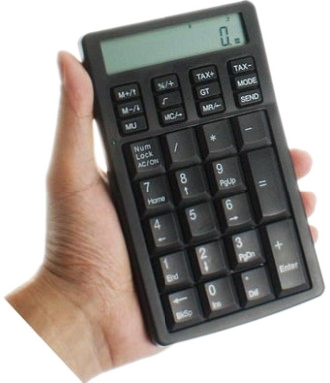
Computational Accuracy
Functional accuracy testing can include tests of computational accuracy
Testing of computation accuracy is critical for applications with math-intensive functionality
Applications for statistics, accounting, science, engineering, etc.

Slide 13

Functional Suitability
Can the System Really Solve the Problem?

Slide 14

Validation
Functional suitability is related to validation
Are we building the right system?

Slide 15
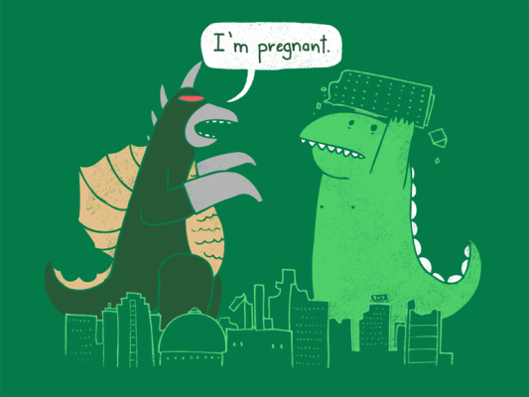
Suitability
What is suitability?
The capability of the software product to provide an appropriate set of functions for specified tasks and user objectives
Given the problem we need to solve, can the system solve it?
Notes:
Example: http://bgkredit.net/calculators/calculator_1.php

Slide 16
Suitability Testing - Example
Suitability testing can be demonstrated with a simple use case example:
E-commerce purchase: Normal workflow
Customer places one or more Items in shopping cart
Customer selects checkout
System gathers address, payment, and shipping information from Customer
System displays all information for User confirmation
User confirms order to System for delivery
Notes:
Example taken from Advanced Software Testing - Vol. 1 - Guide to the ISTQB Advanced Certification as an Advanced Test Analyst [2008]

Slide 17
Suitability Testing – Example (2)
The exceptions of the use case would be:
Exceptions
Customer attempts to check out with an empty shopping cart; System gives an error message
Customer provides invalid address, payment, or shipping information; System gives error messages as appropriate
Customer abandons transaction before or during checkout; System logs Customer out after 10 minutes of inactivity
Notes:
Example taken from Advanced Software Testing - Vol. 1 - Guide to the ISTQB Advanced Certification as an Advanced Test Analyst [2008]

Slide 18
Suitability Testing – Example (3)
A test case for the normal workflow can be:
# | Test Step | Expected Result
1 | Place 1 item in cart | Item in cart
2 | Click checkout | Checkout screen
3 | Input valid address, valid payment using American Express, and valid shipping method information | Each screen displays correctly and valid inputs are accepted
4 | Verify order information | Show as entered
5 | Confirm order | Order in system
6 | Repeat steps 1-5, but place 2 items in cart, and pay with Visa, and ship international | As shown in 1-5
7 | Repeat steps 1-5, but place the maximum number of items in cart and pay with MasterCard | As shown in 1-5
8 | Repeat steps 1-5, but pay with Discover | As shown in 1-5

Slide 19
Suitability Testing – Example (4)
An exceptional test case can be:
# | Test Step | Expected Result
1 | Do not place any items in cart | Cart empty
2 | Click Checkout | Error message
3 | Place item in cart, click checkout, enter invalid address, then invalid payment, then invalid shipping information | Error messages, can't proceed to next screen until resolved
4 | Verify order information | Shown as entered
5 | Confirm order | Order in system
6 | Repeat steps 1-3, but stop activity and abandon transaction after placing item in cart | User logged out exactly 10 minutes after activity
7 | Repeat steps 1-3, but stop activity and abandon transaction on each screen | As shown in 6
8 | Repeat steps 1-4, do not confirm order | As shown in 6

Slide 20

Functional Interoperability
Do Separate Systems Speak The Same Language?
Notes:
http://www.microsoft.com/windows/compatibility/windows-7/en-us/default.aspx

Slide 21
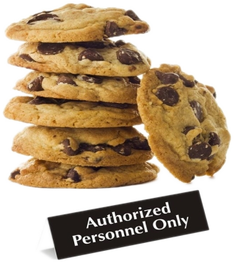
Functional Interoperability
Functional interoperability
Is an application able to function correctly in all intended target environments
Hardware
Software
Connectivity infrastructure
Database systems
Operating systems

Slide 22
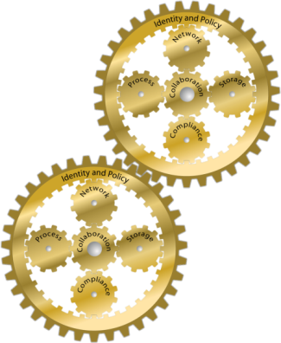
Functional Interoperability (2)
Functional interoperability relates to:
Elements of the environment that the system must interoperate directly with
Elements that it interoperates indirectly with
Elements the system cohabitates with

Slide 23
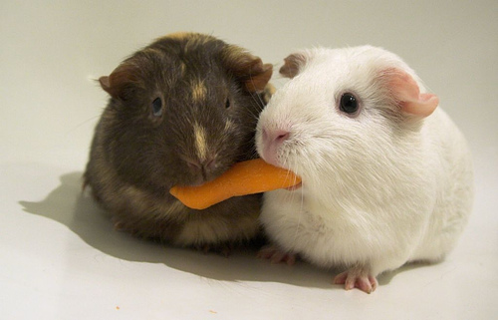
Cohabitation
What do we mean by cohabitating elements?
Applications sharing common resources but without working together
Network infrastructure
CPU capability
Memory space
Etc.

Slide 24

What is a Good Interoperability?
Good interoperability implies ease of integration with other systems
With few if any major changes
Notes:
Interoperability relates to how different software systems interact with each other. Software with good interoperability characteristics can be integrated easily with a number of other systems without requiring major changes.
The number of changes and the effort required to perform those changes may be used as a measure of interoperability.

Slide 25

Accessibility
Notes:
http://www.w3.org/TR/WCAG10/
http://www.w3.org/WAI/
http://www.bbc.co.uk/guidelines/futuremedia/accessibility/

Slide 26

Accessibility Testing
Accessibility testing
Tests the ability of users with particular requirements, restrictions, or disabilities to use the system

Slide 27

Why Accessibility is Needed?
Accessibility of a system is usually required by different factors:
National standards
Voluntary guidelines
Law or contract requirements
May force us to test every field and function with each assistive technology

Slide 28
Accessibility Requirements Example
An example of an accessibility requirement could look like this:
When electronic forms are used, the form shall allow people using assistive technology to access the information, field elements, and functionality required for completion and submission of the form, including all directions and cues.
U.S. Section 508
Notes:
http://wave.webaim.org/
(wikipedia.org; google.bg; abv.bg; etc.)

Slide 29

Usability
Notes:
http://www.groovemanifesto.net/articles/article.php?porn=usability/101
http://www.useit.com/alertbox/

Slide 30

What is Usability Testing?
What is usability testing?
Testing to determine the extent to which the software product is
Understood
Easy to learn
Easy to operate
Attractive to the users under specified conditions
Usability testing focuses on the users

Slide 31

What Could Be Useful?
Usability testing focuses on the users
Some knowledge in fields other than technology can be useful:
Psychology
Sociology
Ergonomics
Understanding of national standards related to accessibility

Slide 32

Characteristics of a Usable Software
Effectiveness
Does the software enable the users to achieve their goals accurately and completely
Under expected usage conditions
Efficiency
Can users achieve his goals in some realistic, reasonable period
Satisfaction

Slide 33

Attributes of a Usable Software
Understandability
The simplicity or difficulty of figuring out:
What the software does?
Why you might need to use it?
Learnability
The simplicity or difficulty of figuring out
How to make the software do what it does?

Slide 34

Attributes of a Usable Software (2)
Operability
The degree of simplicity or difficulty inherent in carrying out certain distinct tasks within the software's feature set
Attractiveness
The extent to which the software is visibly pleasing, friendly, and inviting to the use

Slide 35
Some Examples
http://www.webpagesthatsuck.com/worst-website-navigation-of-2011.html
www.shmarketing.co.uk
http://www.freizeitparkherne.de

Slide 36
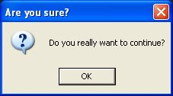
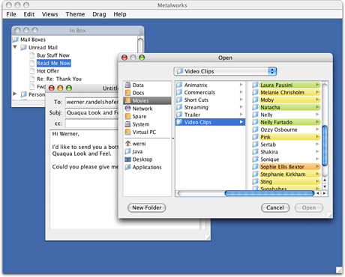
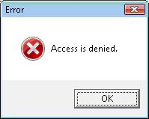
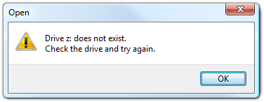
Look and Feel Standards
User interface should follow existing standards of the platform used

Slide 37

Usability Testing Techniques

Slide 38
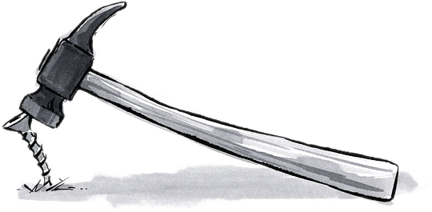
Usability Testing Techniques
There are three main techniques for usability testing:
Inspection (evaluation, review)
Validation of the actual implementation
Survey (questionnaire)

Slide 39

Inspection (Evaluation, Review)
Inspection (evaluation, review)
Involves considering the specification and designs from a usability point of view
Effective and efficient way for early bug discovery

Slide 40
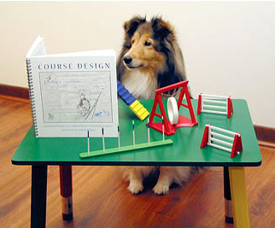
Heuristic Evaluation
Heuristic evaluation is a form of review
A systematic inspection of a user interface design for usability
It allows us to find usability problems in the design, resolve them, and then reevaluate
Cycle is repeated until wanted quality is achieved

Slide 41

Validation of the Actual Implementation
Running usability test scenarios
Looking at usability attributes
E.g., speed of learning or operability
May also include pretest and posttest interviews for the users

Slide 42
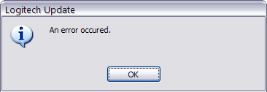
Validation of the Actual Implementation (2)
Syntax tests
Evaluate what the interface allows / disallows
Semantic tests
Evaluating meaningfulness of messages and outputs

Slide 43
Surveys
Survey or questionnaire
Another form of usability testing
Can be used to gather observations of the users' behavior during interaction with the system in a usability test lab
Standard and publicly available surveys
Software Usability Measurement Inventory (SUMI)
Website Analysis and Measurement Inventory (WAMMI)
Notes:
http://sumi.ucc.ie/uksample.pdf
http://www.wammi.com/samples/index.html

Slide 44
Quality Attributes for Domain Testing
?
?
?
?
?
Questions?
?
?
?
?
?
?

